Slide 1
Motion
Chapter 7
Page 206 - 237

Slide 2
Page Setup
Set up the first page of every lesson like this and rule a column line for every page after the first page that is used during the lesson.
Focus: State the Chapter Number, Title and the page numbers (3 lines).
Keywords: During the lesson write out your own keywords used during the lesson. (8 lines)
Context: During the lesson write in this section what this topic relates to in the ‘real’ world. How is this content used to better society? (5 lines)

Slide 3
Motion
Chapter 7.1
Page 206 - 215

Slide 4
VECTORS
H
A
V
E
MAGNITUDE
A
N
D
D
I
R
E
C
T
I
O
N
Vector quantities are those that can only be fully described by specifying a direction as well as a magnitude. Force, displacement, velocity and acceleration are all examples of vector quantities.

Slide 5
SCALARS
HAVE
MAGNITUDE
ONLY
Scalar quantities are those that can be described without specifying a direction. Mass, energy, time and temperature are all examples of scalar quantities.

Slide 6
SCALARS
VECTORS
Distance
Displacement
Speed
Velocity
Mass
Acceleration
Energy
Force
Density
Momentum

Slide 7
Example 7.1a
N
One Dimensional Vectors
A: 3 m
B: 2 m
C: –5 m
A + B
B + C
A + B + C
D + E
E + F
A – B
D: 1 m
E: –3 m
F: 5 m

Slide 8
Example 7.1b
Solve the vector
N
R = ?
3 km North
θ
4 km East

Slide 9
Example 7.1c
What is the resultant force R ?
6N
8N
We ADD vectors HEAD to TAIL [tip to toe]
And we DRAW TO SCALE
8N
6N
R
θ

Slide 10
Example 7.1d
N
Two Dimensional Vectors
A: 3 m
B: 2 m
C: –5 m
A + D
A + E
C + F
C – F
A + B + E
A – C + 2F – E
D: 1 m
E: –3 m
F: 5 m

Slide 11
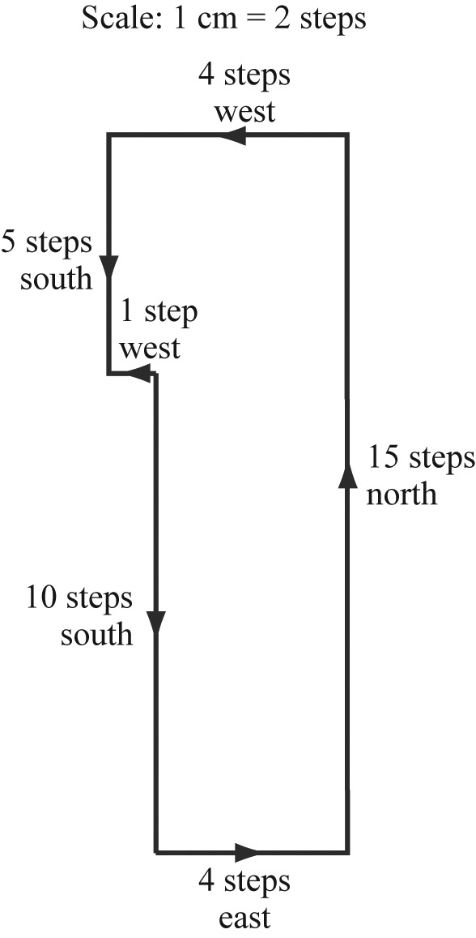
Example 7.1 e
Liam, aged 7, buried some ‘treasure’ in his backyard and wrote down these clues for you to find it:
start at the clothes line, walk 10 steps south, then four steps east, 15 steps north, five steps west, and five steps south.
a) What distance (in steps) is travelled while tracing the ‘treasure’?
b) Where is the ‘treasure’ buried?
c) What is your displacement (in steps) as you follow the instructions?

Slide 12
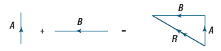
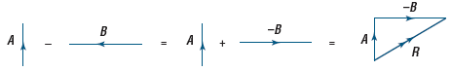
Vectors
Two vectors aiding is the addition of vectors to find the resultant vector.
“Change in …” is the subtraction of vectors to find the resultant vector.
That is, Δv = (v − u) or Δv = v + (−u).

Slide 13

Video

Slide 14
When there is no acceleration
Speed is a measure of the rate at which an object moves over a distance. Because distance is a scalar quantity, speed is also a scalar quantity.
average speed = distance travelled
time interval
Velocity is a measure of the rate of displacement. Because displacement (change in position) is a vector quantity of an object, velocity is also a vector quantity.
average velocity = change in displacement
time interval

Slide 15
Example 7.1f
N
PHYSICS BUS
100 m
in 4 seconds
Distance travelled = ?
Displacement = ?
Speed = ?
Velocity = ?

Slide 16
Example 7.1g
James goes for a run. He jogs 120 m north in a time of 25 s, then turns and walks 40 m south in a further 20 s before stopping.
Calculate James’s average speed as he is jogging.
What is his average velocity as he is jogging?
What is the average speed for this 160 m exercise?
Determine the average velocity for this activity.
What is James’s average velocity for the last 25 s?
What is James’s average velocity in km h^{–1}?

Slide 17
Example 7.1h
James friend Josh goes for a longer run. He jogs 5 km east for 40 mins, then turns south and jogs another 2km. He completed the entire jog in 1 hour.
Calculate Josh’s average speed as he is jogging.
What is his average velocity as he is jogging?
What is his change in velocity while jogging?

Slide 18
Area Under the Line
Velocity: v_{av} = ∆s
∆t
If we rearrange the equation, then;
∆ s = v_{av} × ∆ t
Now we can find the displacement at any time interval using the area under the curve.
Velocity (m s⁻¹)
Time (s)
Example 7.1i: What is the displacement at 10 s?
Find the area under the line

Slide 19
Gradient of the Line
Velocity: v_{av} = ∆s
∆t
Knowing
gradient (m) = rise
run
Now we can find the velocity.
Displacement (m)
s_{f} – s_{i}
= 35–10
=25 m
t_{f} – t_{i}
= 15.5–4
=11.5 s
Time (s)
Example 7.1j: Find the velocity?

Slide 20
Terminology
Instantaneous speed is the speed at a particular instant of time.
Instantaneous velocity is the velocity at a particular instant of time.

Slide 21
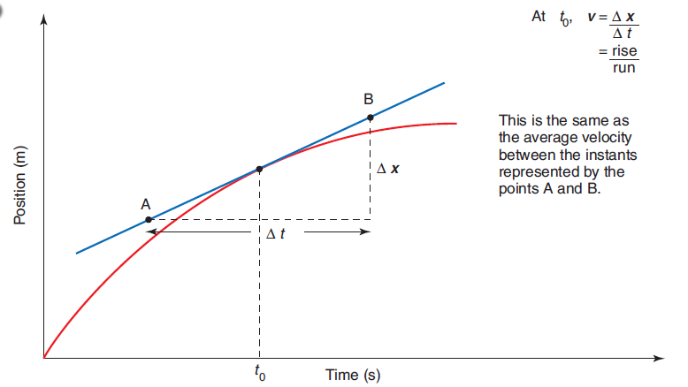
Displacement Graph
20
W
11
2
6
Finding the instantaneous velocity on a curved displacement graphs.
At W: v_{av} = ∆s = s_{f} – s_{i} = 20 – 11 = 2.25 m s⁻¹
∆t t_{f} – t_{i} 6 – 2
Hence at t = 4 seconds the velocity is 2.25 m s⁻¹.

Slide 22
Homework, Context & Keywords
Context: How is this content used to better society?
The apply the principles of motion to improve the application motion in sports and technological developments; such as cars.

Slide 23
Homework, Context & Keywords
Key Words
Scalar
Vector
Distance
Displacement
Speed
Velocity
Acceleration
Instantaneous
Gradient

Slide 24
Homework, Context & Keywords
Homework
Complete all questions from Set 7.1 - due first lesson next week.
Read Chapter 7.2, page 216-225 and answer
Q1 & Q2 Set 7.2
by next lesson.

Slide 25
Page Setup
Set up the first page of every lesson like this and rule a column line for every page after the first page that is used during the lesson.
Focus: State the Chapter Number, Title and the page numbers (3 lines).
Keywords: During the lesson write out your own keywords used during the lesson. (8 lines)
Context: During the lesson write in this section what this topic relates to in the ‘real’ world. How is this content used to better society? (5 lines)

Slide 26
Speed, Velocity and Acceleration
Chapter 7.2
Page 216 - 225

Slide 27
Equations of Motion
SYMBOLS
a = acceleration (m s⁻²)
u = initial velocity (m s⁻¹)
v = final velocity (m s⁻¹)
s = displacement (m)
t = time taken (s)

Slide 28
Terminology Recap
Speed
v_{av} = ∑s
∑t
Velocity
v_{av} = ∆s = s_{f} - s_{i}
∆t t_{f} - t_{i}
This is when there is NO acceleration

Slide 29
Acceleration
The rate at which an object changes its velocity is called its acceleration. Because velocity is a vector quantity, it follows that acceleration is also a vector quantity.
average acceleration = change in velocity
time interval
the change in velocity is (v_{final} – v_{initial})
Acceleration
a_{av} = Δv = v_{f} - v_{i}
Δt t_{f} - t_{i}

Slide 30
Acceleration
Example 7.2a:
Determine the average acceleration of each of the following objects.
A car starting from rest reaches a velocity of 60 km h⁻¹ due north in 5.0 s.
A car travelling due west at a speed of 15 m s⁻¹ turns due north at a speed of 20 m s⁻¹. The change occurs in a time interval of 2.5 s.
A cyclist riding due north at 8.0 m s⁻¹ turns right to ride due east without changing speed in a time interval of 4.0 s.

Slide 31
Area and Gradient of the Line
Velocity (m s⁻¹)
Time (s)
Example 7.2b: Using the graph, find:
Acceleration
Displacement at 10 s
Displacement at 24 s
a = 1.28 m s⁻²
s = 125 m
s = 516 m

Slide 32
Area and Gradient of the Line
A
C
Velocity (m s⁻¹)
D
B
Time (s)
Example 7.2c: Using the graph, find:
Acceleration at 2 s
Acceleration at 8 s
Displacement at 4 s
Displacement at 10 s
a = 1.4 m s⁻²
a = –1.2 m s⁻²
s = 23 m
s = 67.5 m

Slide 33
Area Under the Line
Similarly with acceleration: Δv = a_{av} × Δt
Acceleration (m s⁻²)
Time (s)
Time (s)
Example 7.2d: What is the velocity at 15 s?

Slide 34
What is this graph telling us
B
C
Velocity (m s⁻¹)
A
Time (s)
A-B: The object is accelerating in the positive direction away from the origin. At t = 0 it is 3 m s⁻¹, but increases to 10 m s⁻¹ after 5 seconds.
B-C: The object is decelerating in the positive direction away from the origin. At t = 5 it is 10 m s⁻¹, but decreases to 4 m s⁻¹ after 5 seconds. Has not come to a stop.

Slide 35
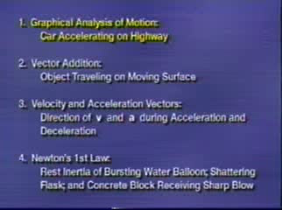
Video

Slide 36
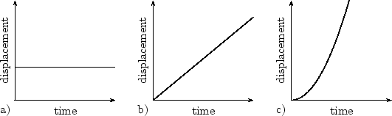
Displacement Graph
Standing still.
Displacement is unchanged over time.
Moving at a constant velocity. For every second that passes the same distance is covered.
Moving at an increased velocity. For every second that passes “double” that of the previous distance is covered.

Slide 37
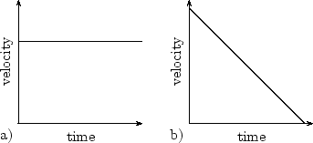
Velocity Graph
Moving at a constant velocity over a period of time. The gradient is zero, so the object is not accelerating.
Shows the object decreasing its velocity as time goes by (decelerating). The gradient, however, stays constant, so the acceleration is constant. The gradient is also negative, so the object is accelerating in the opposite direction to its motion, hence it is decelerating.

Slide 38
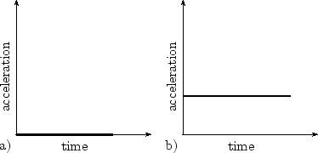
Acceleration Graph
Shows the object is either stationary or travelling at a constant velocity. Either way, the acceleration is zero over time.
Shows the object moving at a constant acceleration. In this case the acceleration is positive - remember that it can also be negative (decelerating).
Acceleration can be linearly increasing or decreasing, but for Year 11 we will assume it is constant.

Slide 39
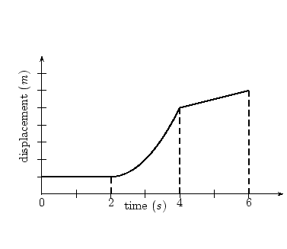
Displacement Graph
C
First 2 seconds
displacement is constant
(object is not moving).
Between 2 & 4 seconds,
displacement is increasing.
The gradient is not constant (The slope or gradient is increasing), hence it is accelerating.
Between 4 & 6 seconds the displacement is increasing with time, however the gradient is constant, hence the object is moving at a constant rate (constant velocity).
B
A

Slide 40
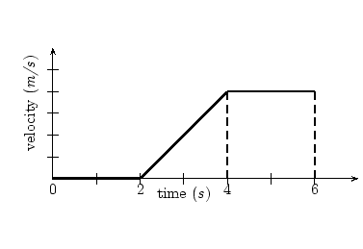
Velocity Graph
C
B
First 2 seconds gradient
is horizontal at zero - so
the object is not moving.
Between 2 & 4 seconds,
velocity has a positive gradient, hence velocity is increasing, so there is positive acceleration.
Between 4 & 6 seconds the object is travelling with a constant velocity, and thus the object is not accelerating.
A

Slide 41
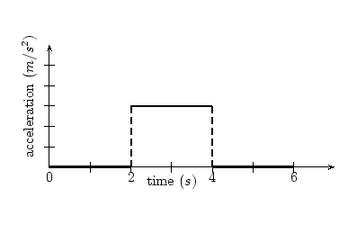
Acceleration Graph
B
For the first 2 seconds
there is no acceleration.
Between 2 & 4 seconds,
there is constant positive
acceleration.
Between 4 & 6 seconds there is no acceleration.
A
C

Slide 42
Linking Graphs
C
All three graphs looked at are telling the same story, just from a different perspective.
Often the displacement graph is the most informative.
So recap.
Not moving
Accelerating
Constant velocity
B
A
C
B
A
B
A
C

Slide 43
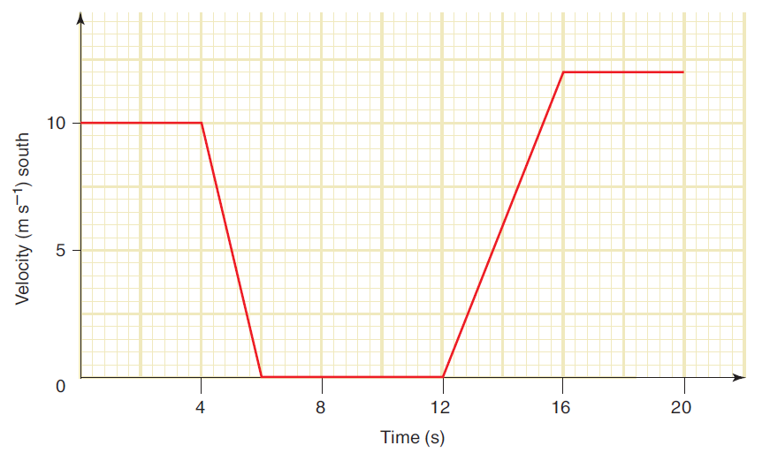
Graphing Motion
Example 7.2e: The velocity-time graph below describes the motion of a car as it travels due south through an intersection. The car was stationary for 6.0 s while the traffic lights were red.
(a) What was the displacement of the car during the interval in which it was slowing down?
(b) What was the average acceleration of the car during the first 4.0 s after the
lights turned
green?
(c) Determine the
average velocity
of the car during
the interval
described by the
graph.

Slide 44
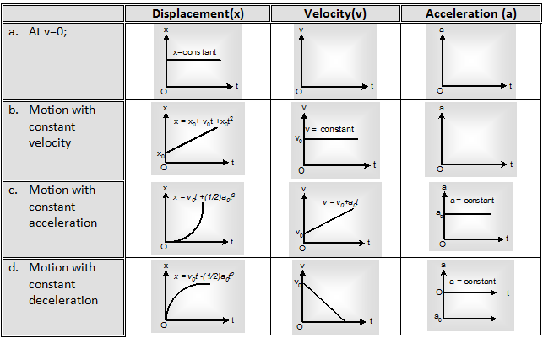
The Four Combinations

Slide 45
Graphing Motion
B
A
C
Distance (m)
Example 7.2f
Sketch a velocity versus time graph.
Sketch an acceleration versus time graph.

Slide 46
C1
Distance (m)
C
C2
Time (s)

Slide 47
Distance (m)
Velocity (m s⁻¹)
Acceleration (m s⁻²)
Time (s)

Slide 48
Homework, Context & Keywords
Context: How is this content used to better society?
The apply the principles of motion to improve the application motion in sports and technological developments; such as cars.

Slide 49
Homework, Context & Keywords
Key Words
Distance
Displacement
Speed
Velocity
Acceleration
Instantaneous
Gradient
Area under a line

Slide 50
Homework, Context & Keywords
Homework
Complete all questions from Set 7.2 - due first lesson next week.
Read Chapter 7.3, page 226-237 and answer
Q1,2 Set 7.3
by next lesson.

Slide 51
Page Setup
Set up the first page of every lesson like this and rule a column line for every page after the first page that is used during the lesson.
Focus: State the Chapter Number, Title and the page numbers (3 lines).
Keywords: During the lesson write out your own keywords used during the lesson. (8 lines)
Context: During the lesson write in this section what this topic relates to in the ‘real’ world. How is this content used to better society? (5 lines)

Slide 52
Equations of Motion
Chapter 7.3
Page 226 - 237

Slide 53
Equations of Motion
When acceleration is zero (a = 0)
v = s
t
When acceleration is not zero (a ≠ 0)
v = u + a t
s = u t + ½ a t²
v² = u² + 2 a s

Slide 54
Equations of Motion
v = u + a t
s = u t + ½ a t²
v² = u² + 2 a s
1. Write down the parameters that you know and include the vector direction for each.
2. Write down the symbol of the quantity that you require.
3. Select the equation that contains all of the symbols in step 1. and 2. above.

Slide 55
Equations of Motion
Example 7.3a:
A snowboarder in a race is travelling at 10 m s^{–1} as she crosses the finishing line. She then decelerates uniformly until coming to rest over a distance of 20 m.
a) What is her acceleration as she pulls up?
b) How long does she take to come to rest?
c) Calculate the average speed of the snowboarder as she pulls up.

Slide 56
Equations of Motion
Example 7.3b:
A car starts from rest and accelerates uniformly for 8.0 s. It reaches a final speed of 16 m s^{–1}.
a) What is the acceleration of the car?
b) Calculate the distance travelled by the car.
c) What is the average velocity of the car?

Slide 57
Equations of Motion
Example 7.3c:
A book is knocked off a bench and falls vertically to the floor. If the book takes 1.0 s to fall to the floor, calculate:
a) its speed as it lands
b) the height from which it fell
c) the distance it falls during the first 0.5 s
d) the distance it falls during the final 0.5 s.

Slide 58
Equations of Motion
Example 7.3d:
A new model BMW can start from rest and travel 400 m in 16 s.
a) What is its average acceleration during this time?
b) Calculate the final speed of the car.
c) How fast is this final speed in km h^{–1}?

Slide 59
Equations of Motion
Example 7.3e:
John throws a ball in the air at a velocity of 6 m s⁻¹ and then catches it in the same position he threw it from. Calculate;
a) The time it took from the moment it left his hand until it returned.
b) The maximum height

Slide 60
Equations of Motion
Example 7.3f:
Sandra throws a rock down a cliff with a velocity of 15 m s⁻¹ and then times how long it takes before she sees it hit the bottom (cloud of dust). If it took 5.29 s to hit the base, calculate the height of the cliff.

Slide 61
Equations of Motion
Example 7.3g:
In class Henry notices a piece of Velcro stuck, face down on the ceiling. He decides he is going to throw his tennis ball at it, so it sticks. If he throws it too hard the force of impact will cause it to rebound and not stay in position and if he throws it too soft then the ball wont reach the ceiling. Make assumptions and calculate at what velocity he needs to release the ball in order to have the ball just touch the Velcro and stick.

Slide 62
Homework, Context & Keywords
Context: How is this content used to better society?
The apply the principles of motion to improve the application motion in sports and technological developments; such as cars.

Slide 63
Homework, Context & Keywords
Key Words
Equations of Motion
Distance
Displacement
Speed
Velocity
Acceleration

Slide 64
Homework, Context & Keywords
Homework
Complete all questions from Set 7.3 - due first lesson next week.
Read No Chapter by next lesson.

Slide 65
Page Setup
Set up the first page of every lesson like this and rule a column line for every page after the first page that is used during the lesson.
Focus: State the Chapter Number, Title and the page numbers (3 lines).
Keywords: During the lesson write out your own keywords used during the lesson. (8 lines)
Context: During the lesson write in this section what this topic relates to in the ‘real’ world. How is this content used to better society? (5 lines)

Slide 66
Projectile Motion
No Chapter (7.4)

Slide 67



Projectile Motion
Example: car driving off a cliff
Half Projectile
Full Projectile
Partially Projectile
Example: Javelin throw
Example: shot put throw

Slide 68
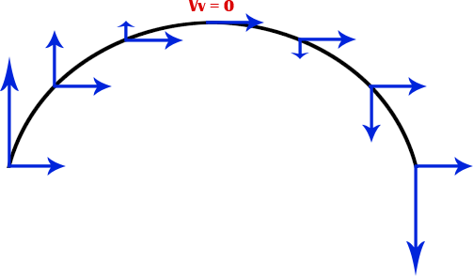
Projectile Motion
Important Information
Treat your vertical and horizontal as separate components.
v_{h} remains constant,
v_{v} (at max height) = 0
a_{h} = 0,
a_{v} = 9.8 ms⁻²
Assumptions
air resistance is ignored.

Slide 69

Projectile Motion
When considering air resistance
Bull nose
Less height
Which hits the ground first?
Black line – air resistance results in the object slowing down, hence it does not reach full height, but it is falling at a slower rate than if there was no air resistance. Hence the air resistance slows the object continuously relative to the object not experiencing air resistance.

Slide 70
Full Projectile Motion
Example 7.4a: Cannon ball is fired into the air at 50 m s⁻¹ at an angle of 37.5º to the horizontal. Assuming no effects from air resistance.
a) Find the maximum height
b) Find its time in flight.
c) Find its range.

Slide 71
Full Projectile Motion
Example 7.4b: One student throws a ball to another student who is the same height at a speed of 19 m s⁻¹ at an angle of 41º from horizontal. (Ignoring air resistance)
a) How long does it take to reach the other student?
b) How far does the ball travel to reach the other student?
c) Find the maximum height?

Slide 72
Full Projectile Motion
Example 7.4c: An athlete rests a shot put on their shoulder at 1.5 metres above the ground. The shot put is launched at a 30º angle above horizontal and at a speed of 6.5 m s⁻¹ and lands on a sand mound at the same height. (Ignoring air resistance).
a) Calculate the initial vertical and horizontal velocities
b) Calculate the time of travel of the ball.
c) Calculate the range of the ball.

Slide 73
Full Projectile Motion
Example 7.4d: A Cannon fires a cannon ball from a cliff 12 metres high at an angle of 30º from horizontal and at a speed of 36 m s⁻¹. It hits a castle on another cliff at the same height (Ignoring air resistance).
a) Calculate the time of travel to hit the ground below?
b) How far does the cannon ball travel before impact?
c) Find the maximum height from the point of impact?

Slide 74
Full Projectile Motion
Example 7.4e: Natasha serves a “friendly” underarm volley in tennis with a velocity of 27 m s⁻¹ at an angle of 15º from the horizontal. The ball is hit by the opponent at the same height, calculate; (Ignoring air resistance).
a) The time of flight between Natasha’s serve and the opponent striking it back.
b) The distance between the two players.

Slide 75
Homework, Context & Keywords
Context: How is this content used to better society?
To design and understand how objects fall and behave during two dimensional motion.

Slide 76
Homework, Context & Keywords
Key Words
Centre of Mass
Projectile motion
Partial
Full
Half
Air Resistance
Bull nose

Slide 77
Homework, Context & Keywords
Homework
Complete all questions from handout - due first lesson next week.
Complete Chapter 7 Review, page 240-241 - due first lesson next week.
Read Chapter 8.1, page 242-246 and answer
Q1,2 Set 8.1
by next lesson.

